Slide 1
Implementing Tests for LLM Prompts
with Semantic Assertions
LLM Semantic Evaluator — .NET/C# Framework
Md Abdulla AL Mahamud Rosi
Mr.Nr:1519699
Frankfurt University of Applied Sciences
ML Project 25/26-08 | Module: Software Engineering
OpenAI GPT
xAI Grok
Ollama
.NET 8 / C#

Slide 2
Agenda
WHAT I'LL COVER
01
Problem Statement
02
System Architecture
Why string matching fails for LLM testing
Pipeline design & key interfaces
03
Validation Strategy
04
Implementation
Embeddings + LLM-as-Judge + Majority Vote
Components & configuration
05
Results
06
Unit Testing
4 slides — overview, categories, distributions, failure analysis
85 tests, zero failures across 6 test files
LLM Semantic Evaluator | Frankfurt UAS | ML Project 25/26-08

Slide 3
The Problem with Testing LLMs
PROBLEM STATEMENT
Traditional Testing
Semantic Testing
✗ Exact string match
✓ Embedding cosine similarity
✗ Deterministic output assumed
✓ LLM-as-a-Judge (G-Eval style)
✗ BLEU / ROUGE penalise valid paraphrases
✓ Majority vote across 3 runs
✗ False failures on semantically correct answers
✓ Tolerates valid surface-form variation
Same factually correct answer, many valid surface forms → string equality always fails
LLM Semantic Evaluator | Frankfurt UAS | ML Project 25/26-08

Slide 4
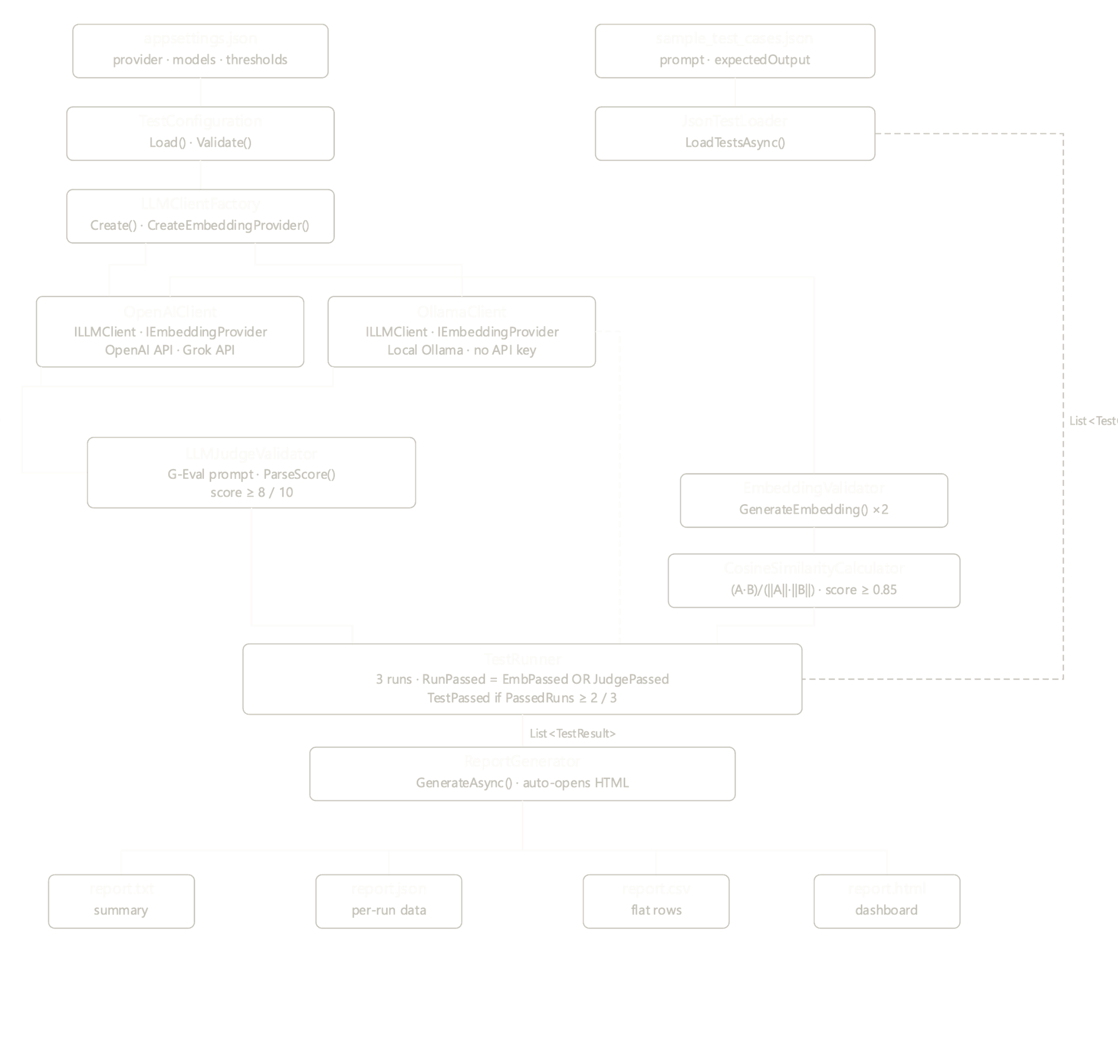
System Architecture
PIPELINE DESIGN
LLM Semantic Evaluator | Frankfurt UAS | ML Project 25/26-08

Slide 5
Hybrid Validation Strategy
TWO VALIDATORS + MAJORITY VOTE
Validator 1 — Embedding
Validator 2 — LLM Judge
• Embed expected + actual output
• G-Eval style chain-of-thought prompt
OR Logic
• Cosine similarity score [−1, 1]
• Reason → SCORE: 1–10
Either validator can pass a run
• Threshold: ≥ 0.85 to PASS
• Threshold: ≥ 8 to PASS
• Fast, consistent, no extra API cost
• Handles short/paraphrased outputs
Majority Vote — 3 runs per test case
Run 1
Run 2
Run 3
PASS
PASS
PASS
FAIL
Pass if ≥ 2 / 3 runs pass | Absorbs API jitter, rate-limit errors & atypical outputs
LLM Semantic Evaluator | Frankfurt UAS | ML Project 25/26-08

Slide 6
Key Implementation Components
IMPLEMENTATION · CONFIG: appsettings.json · PROVIDERS: openai / grok / ollama
TestConfiguration
LLMClientFactory
Reads appsettings.json. Validates API keys, thresholds & provider at startup. Zero code changes across providers.
Factory pattern — OpenAIClient reused for OpenAI & Grok (compatible API). OllamaClient handles local protocol differences.
EmbeddingValidator
LLMJudgeValidator
Calls embedding API twice, computes cosine similarity. Auto-fails empty responses without API call. Catches network errors safely.
Builds G-Eval prompt, sends to judge LLM. Two-stage regex extracts 1–10 score from free-form response.
CosineSimilarityCalculator
ReportGenerator
Single-pass dot-product. Clamped to [−1,1]. Zero vector → 0.0. Exposes InterpretScore() & PassesThreshold() helpers.
Writes report.txt · report.json · report.csv. Auto-opens interactive HTML dashboard in browser on completion.
LLM Semantic Evaluator | Frankfurt UAS | ML Project 25/26-08

Slide 7
Results Overview
130 TEST CASES · 7 KNOWLEDGE DOMAINS · 3 RUNS EACH · MAJORITY VOTE 2/3
97.7%
44.6%
130
85
OpenAI Pass Rate
Ollama Pass Rate
Total Test Cases
Unit Tests Passing
Metric | OpenAI gpt-5-mini | Ollama llama3.2:1b
Passed / Failed | 127 / 3 | 58 / 72
Avg Embedding Score | 0.51 (below 0.85 threshold) | 0.64 (below 0.85 threshold)
Avg Judge Score | 9.7 / 10 | 5.8 / 10
Embedding Model (dims) | text-embedding-3-small (1536d) | nomic-embed-text (768d)
Primary Pass Path | Judge (OR logic essential) | Neither — judge miscalibrated
LLM Semantic Evaluator | Frankfurt UAS | ML Project 25/26-08

Slide 8
Per-Category Pass Rates
OPENAI VS OLLAMA ACROSS 7 DOMAINS
OpenAI
100% on math & reasoning
3 failures — model more accurate than expected output
Ollama
Best: math (65.2%)
Worst: definitions (27.3%) & history (25.0%)
Root cause: judge miscalibration
OR Logic Impact
Avg emb score 0.51 — nearly all OpenAI passes via judge path
LLM Semantic Evaluator | Frankfurt UAS | ML Project 25/26-08

Slide 9
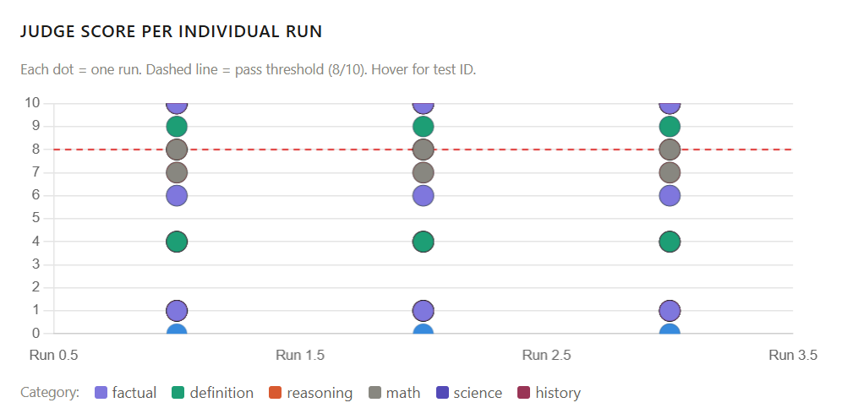
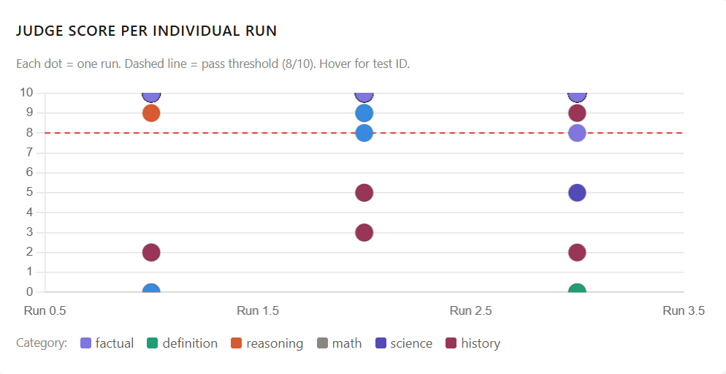
Judge Score Distribution
WHAT THE SCORE DISTRIBUTIONS REVEAL ABOUT EACH PROVIDER
Ollama — Bimodal Distribution
OpenAI — Right-Skewed Distribution
Large cluster at 1–3: judge penalised correct answers Small cluster at 8–10: cases where it scored accurately
Vast majority cluster at 9–10 Avg judge score: 9.7/10 — consistent rubric application gpt-5-mini reliably follows chain-of-thought prompt
LLM Semantic Evaluator | Frankfurt UAS | ML Project 25/26-08

Slide 10
Failure Analysis
OPENAI: 3 FAILURES · OLLAMA: 72 FAILURES — VERY DIFFERENT ROOT CAUSES
OpenAI — 3 Failures
Ollama — 72 Failures
Root cause: model gave a MORE accurate answer than the expected output
Root cause: judge miscalibration — not factual errors in responses
history_020
First to circumnavigate globe
Example — Nazi Germany leader
Expected: Magellan
Response: "Adolf Hitler. He served as Fuehrer from 1934 until his death in 1945."
Actual: Juan Elcano ✓ (Magellan died en route)
Judge score: 1/10 — "only identifies Hitler without specifying his role"
factual_014
World's largest desert
Expected: Sahara
Actual: Antarctic Desert ✓
Example — Capital of France
Response: "The capital of France is Paris." | Expected: "Paris"
science_013
Smallest unit of matter
Expected: atom
Judge score: 6/10 — "sentence does not carry the same meaning as the word"
Actual: elementary particles ✓
Paradox: Ollama avg embedding score (0.64) > OpenAI (0.51) — yet 44.6% vs 97.7% pass rate. Judge quality is the deciding factor.
LLM Semantic Evaluator | Frankfurt UAS | ML Project 25/26-08

Slide 11
Unit Testing
85 TESTS · 0 FAILURES · xUNIT + MOQ · NO LIVE API CALLS
14
JsonTestLoaderTests
15
CosineSimilarityCalculatorTests
File loading, validation, defaults, error paths
Math correctness, edge cases, threshold & interpret
6
EmbeddingValidatorTests
8
LLMJudgeValidatorTests
Mocked provider — pass/fail, empty inputs, API errors
Mocked client — score parsing, formats, edge cases
9
ReportGeneratorTests
12
TestRunnerTests
Real file I/O — txt, json, csv creation & content
Majority vote, aggregation, error handling
dotnet test → Failed: 0 Passed: 85 Skipped: 0 Total: 85 Duration: ~11s
LLM Semantic Evaluator | Frankfurt UAS | ML Project 25/26-08

Slide 12
Discussion & Conclusion
KEY FINDINGS · LIMITATIONS · FUTURE WORK
OR logic is essential
97.7% OpenAI passes via judge path — avg embedding score 0.51 is well below the 0.85 threshold. Without OR, it would fail.
Small LLMs fail as judges
llama3.2:1b (1B params) lacks instruction-following for rubric scoring. Minimum 7–8B recommended for the judge role.
Short-output structural limitation
Single-word expected outputs consistently fail embedding check. Threshold adjustment to 0.70–0.75 advisable for such cases.
Future: Task.WhenAll + BERTScore
Parallelise embedding + judge API calls per run (~50% speedup). Add BERTScore as complementary metric for longer reference texts.
LLM Semantic Evaluator | Frankfurt UAS | ML Project 25/26-08

Slide 13
Thank You
Questions & Discussion
Project: LLM Semantic Evaluator · ML Project 25/26-08
Framework: .NET 8 / C# · xUnit · Moq
Results: 97.7% OpenAI · 44.6% Ollama · 130 test cases
Unit Tests: 85 passing · 0 failures · 6 test files
Source code available in project repository

